Slide 1

Harbor 101
Henry Zhang, Chief Technologist, VMware China
Steven Zou, Staff Engineer, VMware China

Slide 2
Agenda
1 | Introduction to Harbor
2 | Typical Use Cases
3 | Roadmap

Slide 3


Mission
Harbor is a trusted cloud native registry that stores, signs, and scans content. The mission is to provide cloud native environments the ability to confidently manage and serve container images.

Slide 4
Intro to Harbor
Created by VMware in 2014, adopted by users worldwide
Registry for containers and Helm charts
Focus: stores, signs and scans content
Provides consistent experience on- and off-prem
Open Source (Apache 2.0)
Accepted into sandbox stage in July 2018 as first container registry
Moved to Incubation at KubeCon + CloudNativeCon in Shanghai

Slide 5
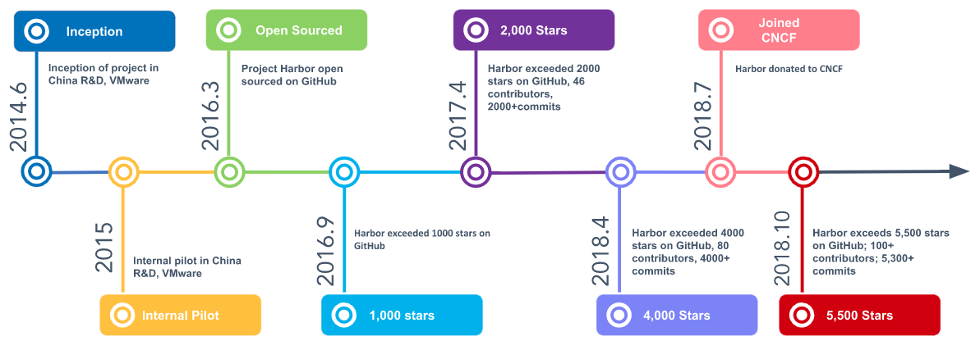
Timeline

Slide 6
Metrics of Engagement

Slide 7
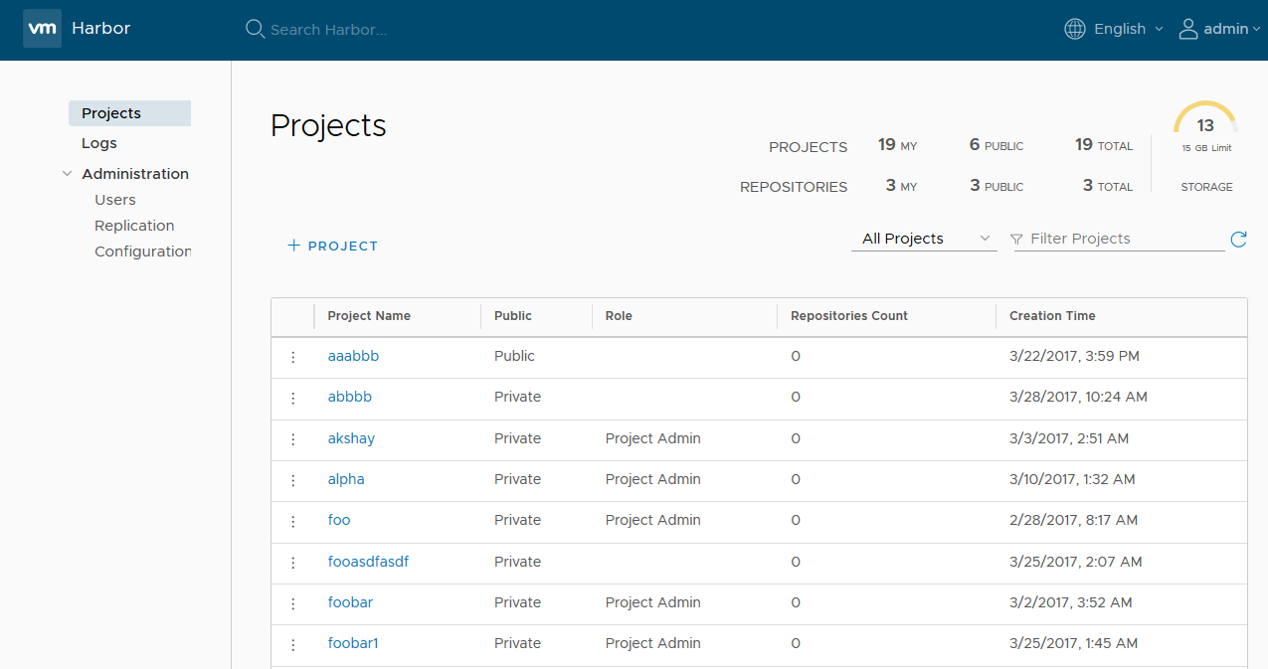
Key Features
Registry features include
Identity integration and role-based access control
Security and vulnerability analysis
Multi-tenant content signing and validation
Image replication between instances
Helm Chart management
Internationalization (currently English and Chinese)
Operational experience
Deployed in containers
Extends, manages, and integrates proven open source components

Slide 8



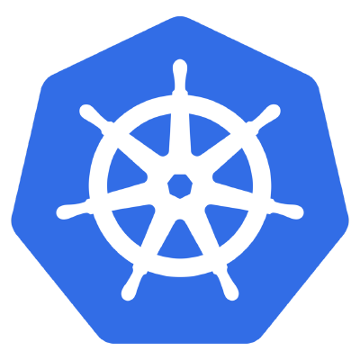
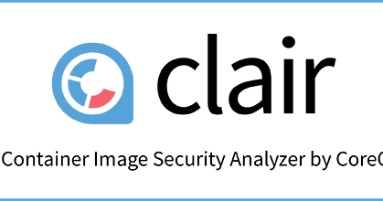


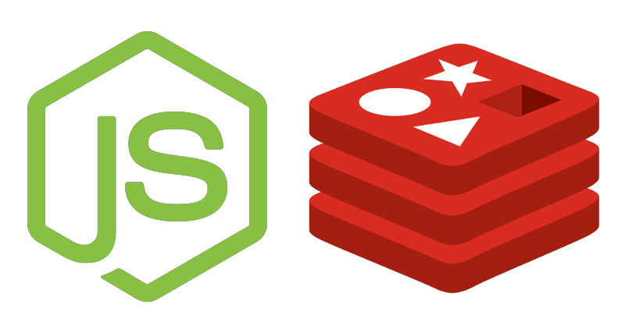

Architecture
Consumers
3rd party components
Users (GUI/API)
Container Schedulers/Runtimes
Harbor components
Persistence components
Supporting services
API Routing
LDAP/Active Directory
Core Service (API/Auth/GUI)
Trusted Content
Docker
Harbor Packaging
Kubernetes
Image Registry
Job Service
Admin Service
Vulnerability Scanning
Key/Value Storage
SQL Database
Local or Remote Storage (block, file, object)

Slide 9
Typical Use Cases
Image consistency through software lifecycle
Shipping images in “binary” format
Image replication unlocks interesting deployment architectures
Auth{Z,N}
Vulnerability scanning
Image signing
Helm chart management

Slide 10
Shipping “Binaries”
Git
Images are synchronized between environments
by using Harbor registry.
images
images
images
CI
Test Registry
Dev Registry
images
images
images
Staging Registry
Production
Registry

Slide 11


Image Replication
Project
Project
Policy
Images
Images
Initial replication
Image
Image
Incremental replication
(including image deletion)

Slide 12

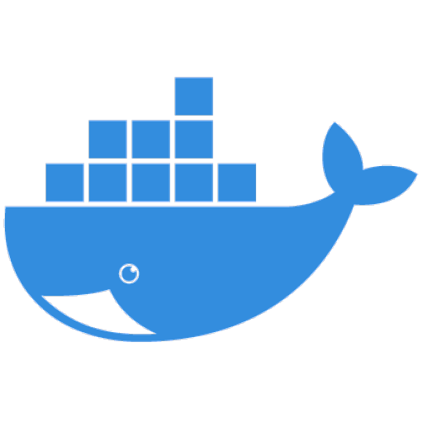

Scaling Horizontally
Docker Client
push
pull
pull

Slide 13


Global Replication
Identical images across multiple sites
Image backup
Local access

Slide 14




Auth{Z,N}
Project
Members
Images
Guest:
docker pull ...
Developer:
docker pull/push
operation & management
Admin:
Settings

Slide 15
Vulnerability Scanning
Leverage Red Hat Clair (née CoreOS)
Set vul’n threshold and block pulls if exceeded
Vulnerability data pulled from vendor DBs
Debian + Ubuntu {Bug,CVE} tracker
Red Hat security data
Oracle Linux security data
Alpine SecDB
NIST

Slide 16
Image signing
Leverage CNCF’s Notary
Sign image when pushing
Enforce signing policy and block pulls of unsigned images
Notary
2. Signature of tag’s manifest
3. Verify signature status, fetch digest.
Verify signature status.
Policy Controller
1. docker push tag
4. docker pull $digest
Image Creator
Registry
Image User

Slide 17

Helm Chart Management
Unify image and Helm Chart management
Access Control
Deployment integration
Replication
Scanning
Digital signature

Slide 18
DEMO

Slide 19
Roadmap
Token-based authentication (via OIDC)
DevOps pipeline support
Robot account
Webhook
Improved replication
replicate both image and chart
harbor <-> non harbor registry
Tag lifecycle management enhancements
Retention policy
Improved content scanning
Cron like schedule
Policy-based scanning
Helm Chart repo improved
Content trust
Lifecycle support of Harbor on K8s
Image proxy’ing + cache
Cacthing of upstream repos (e.g., DockerHub)

Slide 20
Harbor Deep-Dive
Session:
Thursday December 13, 2018 4:30pm - 5:05pm in 3 A/B
Find us! (wearing Harbor shirts)
CNCF Meet the Maintainer booth
Maintainer | Day | Times
James (me) | Tuesday & Wednesday | 2:00pm - 2:30pm
Steven Zou | Wednesday | 2:30pm - 3:30pm
Steven Ren | Thursday | 10:30am - 11:30am

Slide 21
Join the fun!
web: https://www.goharbor.io
gh: https://github.com/goharbor
slack: slack.cncf.io (#habor and #harbor-dev)
Twitter: @Project_harbor

Slide 22


